Slide 1
Digital Marketing Analysis using Google Analytics
Aishwarya Badlani
Sanjana Buchala
Mary Fields
Chanchal Ganrai
Shruti Rajani
Anshumali Shrivastava

Slide 2
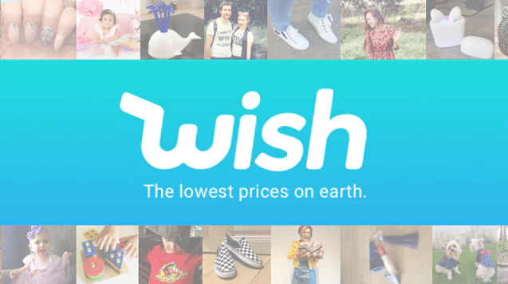
ITINERARY
Company Overview
Current Performance
KPIs & Company Goals
Success Metrics & Analysis
Recommendations

Slide 3
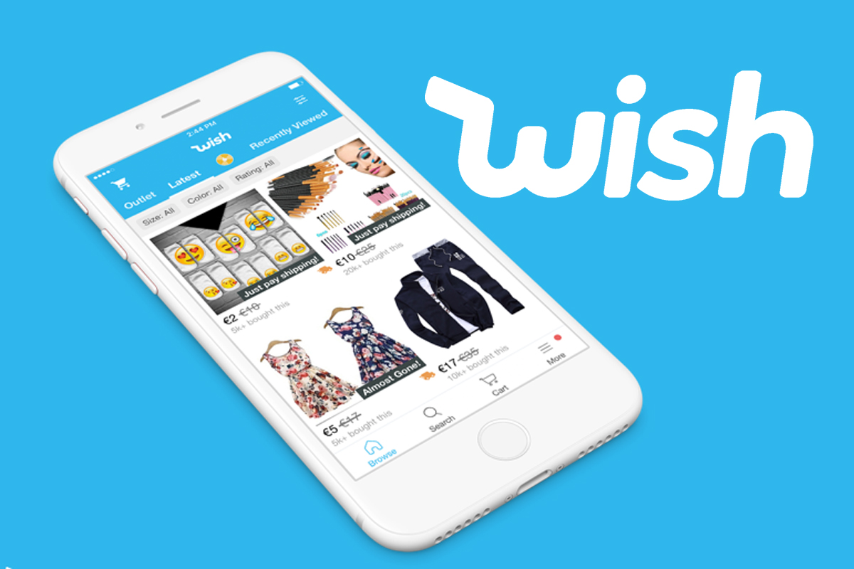
ABOUT WISH.COM
Founded in 2010
Take 15% of transaction
Most downloaded shopping app worldwide of 2018
1+ Million merchants
Estimated worth of $11.2 billion
Connects shoppers directly to factories, eliminating distributor fees which equals step price discounts
Utilizes ContextLogic software that creates custom shopping experience for users
Notes:
Wish is a fast growing, global E-commerce site that connects shoppers directly to merchants allowing for steep discounts in product. They utilize predictive technology to advertise most suited products to customers. They had a series H investment round in August and have their sights set on an IPO in the near future.

Slide 4
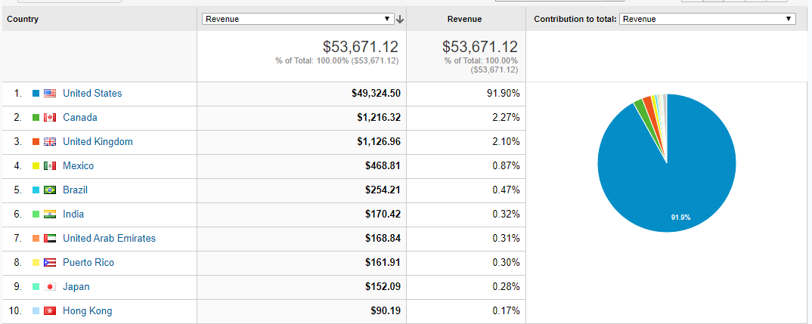
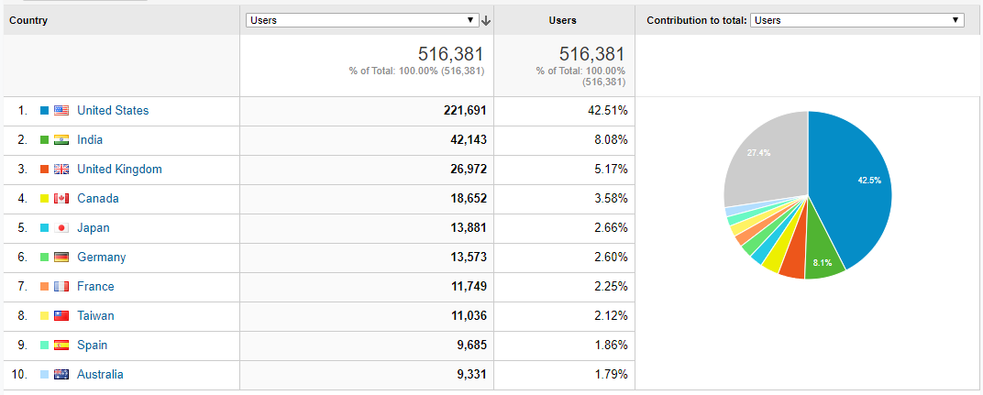
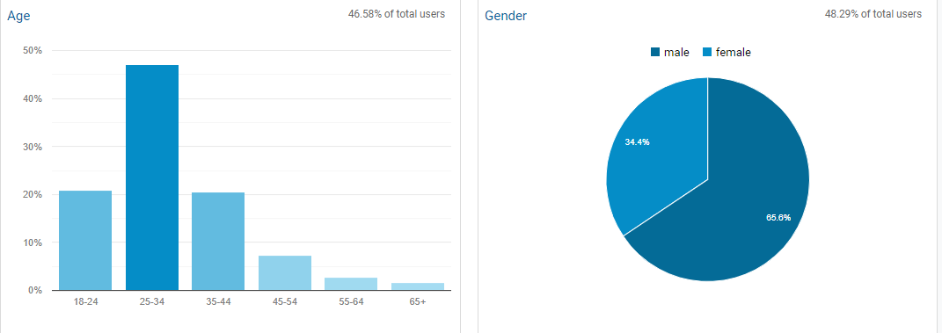
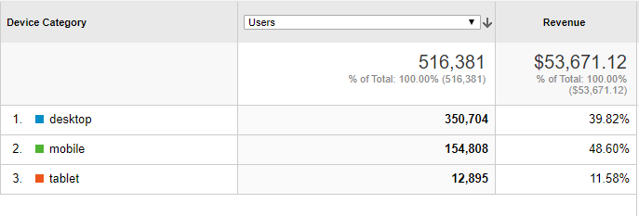
Wish Customer Base: Male, 25 -34, North American, Buys on Mobile
Potential Market
There is high usage from regions like India and Japan but low revenue generate. The company could consider researching these populations further.
Notes:
Main customer base is Male, mid-20’s and from North America. Preliminary customer research showed there may be potential markets in India and Japan as these countries have high app usage but low conversions.

Slide 5

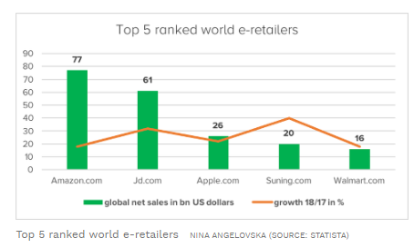
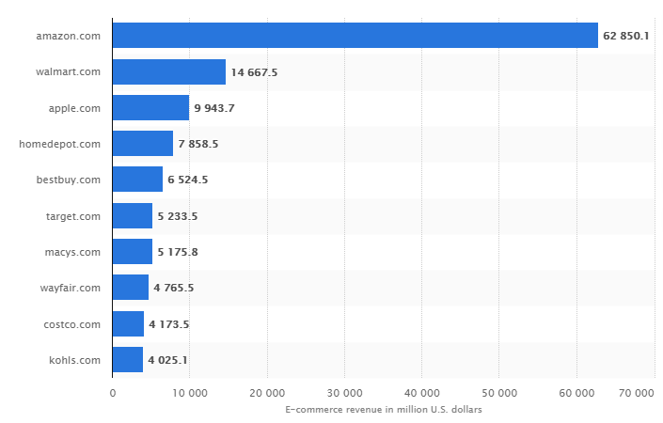
WISH.COM COMPETITOR ANALYSIS
Top e-commerce sites in US
https://www.forbes.com/sites/ninaangelovska/2019/05/20/top-5-online-retailers-electronics-and-media-is-the-star-of-e-commerce-worldwide/#73b3c9d1cd9f
Statista 2019
https://www.statista.com/statistics/646030/united-states-top-online-stores-united-states-ecommercedb/
Notes:
Hello, this is Mary. I’ll be talking a bit more about Wish and then delving into its current performance.
Wish is a global company but gets most of its profits from customers in the U.S. making Amazon, Apple, and Walmart it’s biggest E-commerce competitors because they are also powerful contenders in these markets.

Slide 6
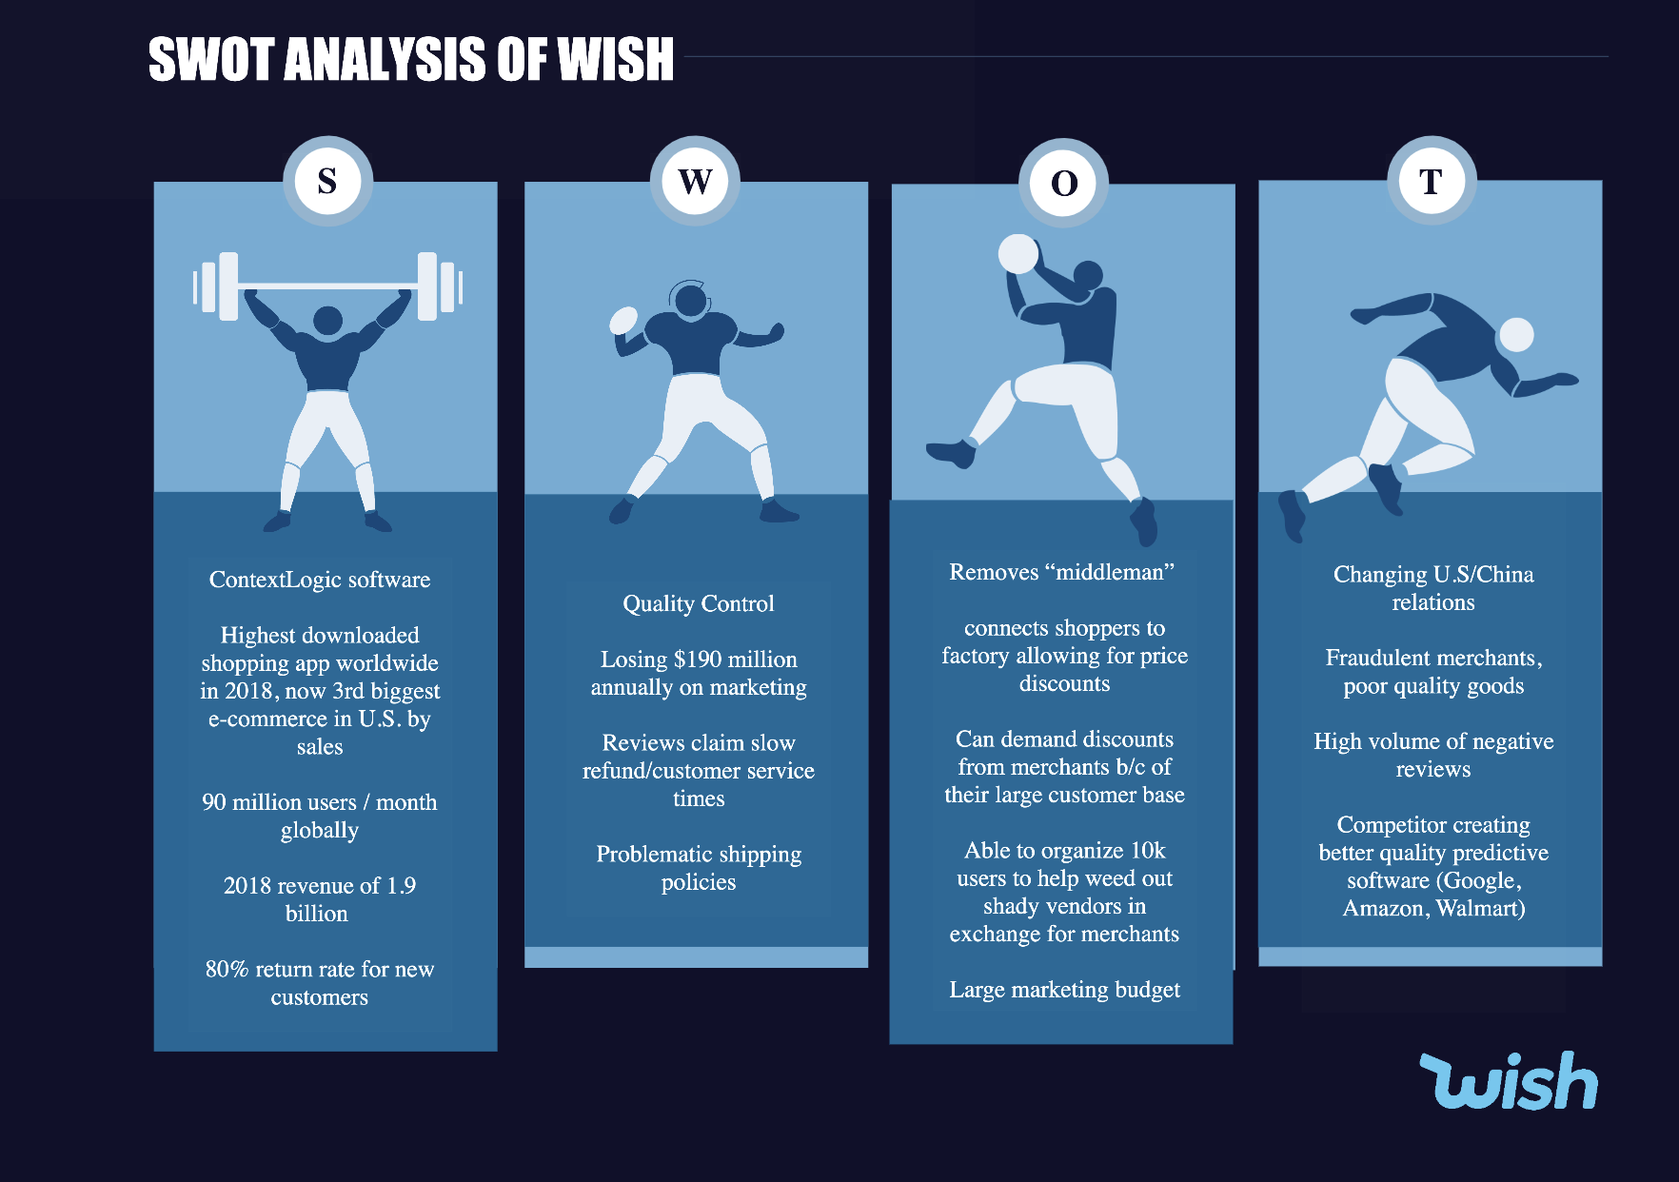
WISH.COM SWOT ANALYSIS
Notes:
Wish’s strength is its ability to create custom customer shopping experiences which has translated into mass appeal. However, the company has faced growing pains in the form of quality control issues and harsh reviews for poor customer service. The company is confident that their ability to cut out the “Middlemen” and deliver deep discounts is strong enough to keep customers engaged. However, in the hopes of improving quality control they have recently incentivized their more loyal followers to report issues in exchange for free products and additional discounts. In addition to their major global competitors, the biggest threat to the company is a continued flood of negative reviews and potentially fraudulent merchants.

Slide 7
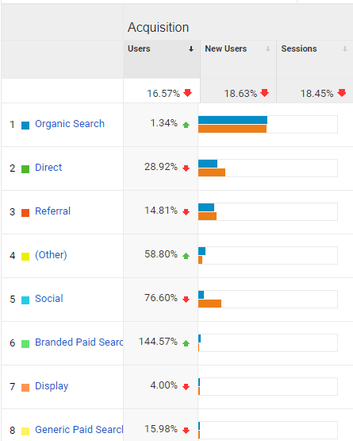
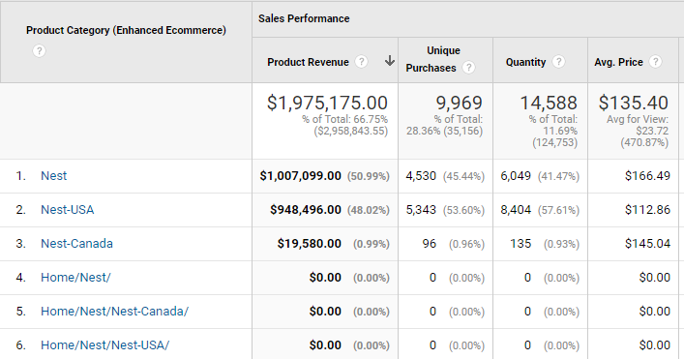
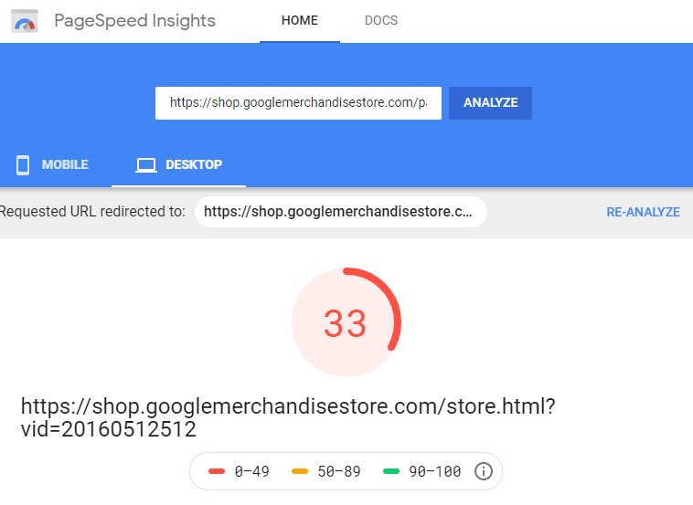
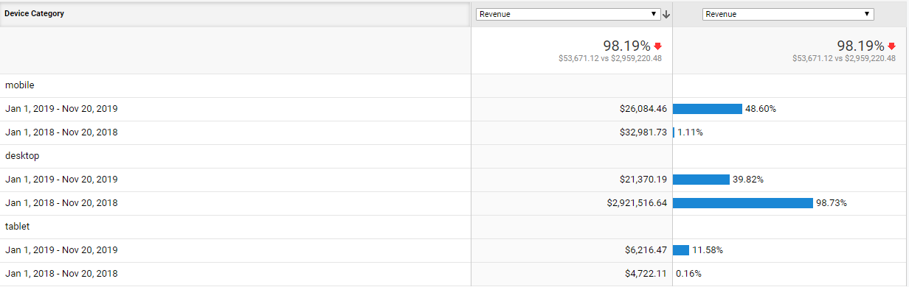
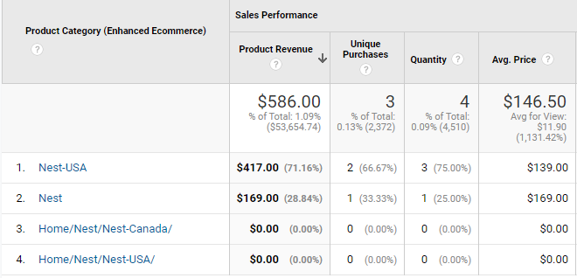
CURRENT COMPANY PERFORMANCE: DECLINES DUE TO THREE CAUSES
1.
Fewer Ad Campaigns causing drop in New Users.
2.
Nest Brand products not being advertised. $1.97M loss
3.
Slow load time for desktop “Payment” pages causing spike in Check-Out abandonment. $2.9M loss
2018
2019
Notes:
Assessing the data in Google Analytics, we found that the company is currently seeing devastating performance declines that appear to have three main causes.
Fewer ad campaigns in 2019 vs 2018 are contributing to a 18.63% drop in New Users coming to the site.
Nest Brand Products that contributed to 66.75% of revenue in 2018 has not been advertised in 2019, resulting in an estimated loss of $1.97M in revenue.
Slow load time for “Payment” pages on desktop is contributing to exceedingly high checkout abandonment rates, resulting in an estimated loss of $2.9M in revenue.
These root problems are negatively impacting all KPIs and Success Metrics which is what lead us to identify them. We will cover those KPIs and Metrics next.

Slide 8
KPI: REVENUE
GOAL
As an a e-commerce company, Wish aims to increase Revenue every quarter by attracting more customers to purchase their products. Increased Revenue means increased profits.
Tracking Revenue involves several metrics that Wish must consider, these include: shopping cart behaviour, checkout behaviour, product performance, and product listing
Unfortunately, Revenue and many of these metrics have experience a drastic negative change from 2018 to 2019.
Shopping Behaviour
Product
Listing
Checkout Behaviour
Product Performance
Notes:
Hence to maintain a firm position in the market WISH must aim at various success metrics such as shopping cart behaviour, checkout behaviour, product listing and sales performance.

Slide 9
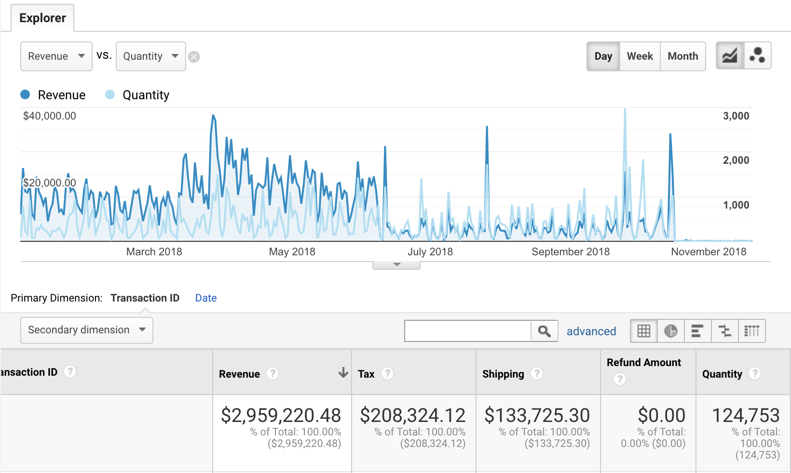
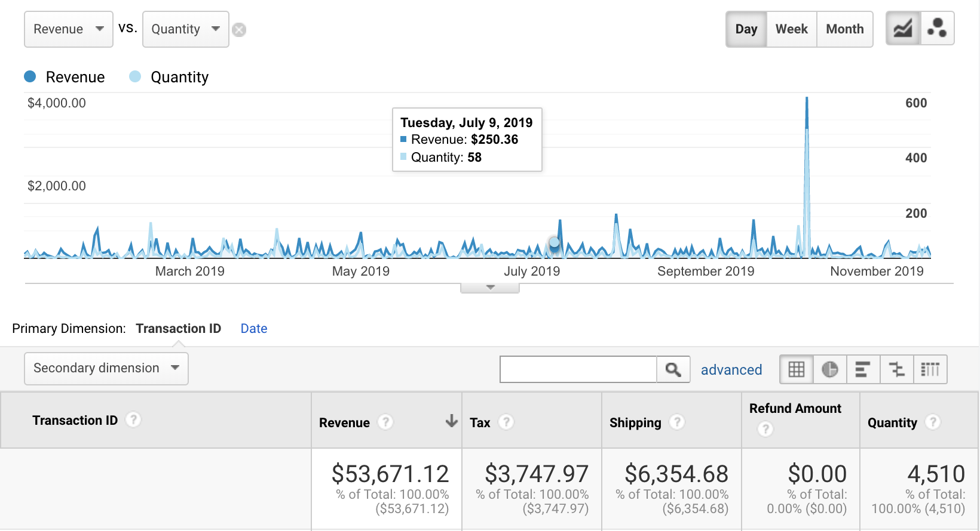
REVENUE: 98% DECREASE
Overall drastic decrease in the revenue from 2018 to 2019 equals $2.9M in lost revenue.
November has been the peak period for both the year, this might be due to the sales and offers.
Noticeable decrease in Revenue was the first sign that there were major problems for the site.

Slide 10
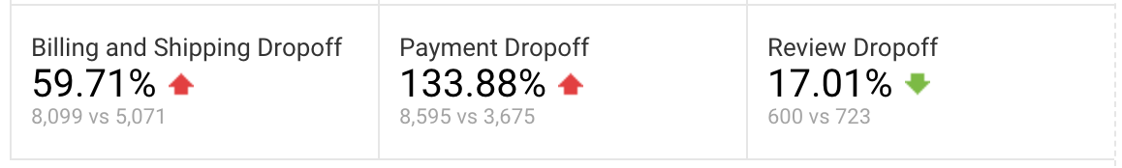
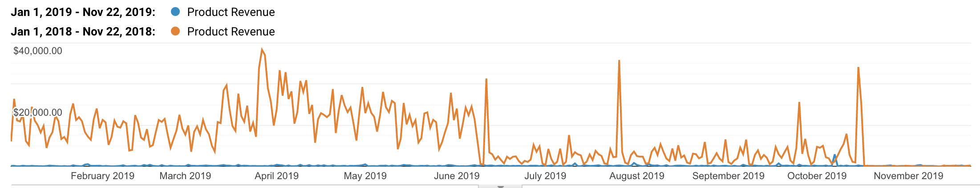
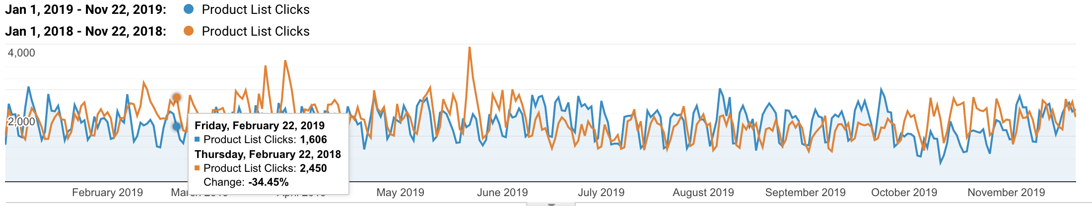
KPI REVENUE: METRICS
Revenue Success Metrics
in Decline
Shopping Behavior: Almost 95% drop in users who are adding to cart to users who are actually buying the products.
Checkout Behavior: Customers add product to cart but don't reach billing or payment page.
Product Revenue: Revenue generation graph based on product has almost 100% decrease.
Product List Performance: On an average, the overall performance of products is decreasing.
Notes:
The drastic drop in Product Revenue and Product List Performance lead us to further analyse popular items from 2018 and 2019. We found that sales for 2018’s most profitable brand, Nest, had plummeted in 2019. The cause of that being a total lack of advertising for the products. Several other more mildly profitable product categories from 2018 had the same issue.

Slide 11
KPI: ACTIVE USER BASE
GOAL
Wish is using a price leadership strategy meaning the number of Active Users is crucial to knowing the health of the company.
Their Active User Base must continue to grow if the company wants to gain market share in such a competitive landscape. Continued growth is especially crucial for Wish to achieve an IPO.
Conversely, a drop in users alerts executives to problems. Because Wish is contending with major competitors like Amazon knowing what the active customer base trend is at all times will help project market share and can signal when competitors may be stealing customers.
Market Share
Pages/
Visit
Session
Duration
Conversions
Notes:
For our Second KPI we selected Active User Base.
To stay lucrative and competitive against competitors like Amazon and Walmart, Wish must maintain and gain Market Share in their industry. Tracking Active User Base is a quick way for Wish to monitor its relative market share and to be alerted if competitors are stealing customers.

Slide 12
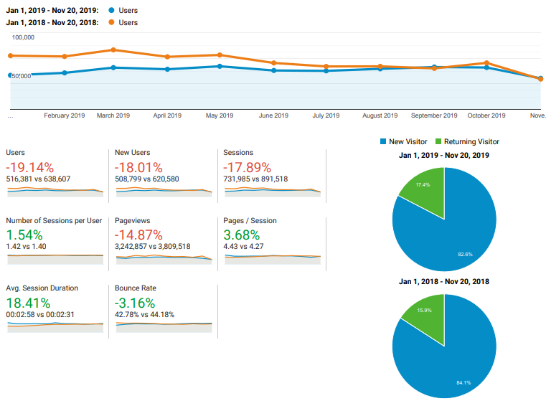
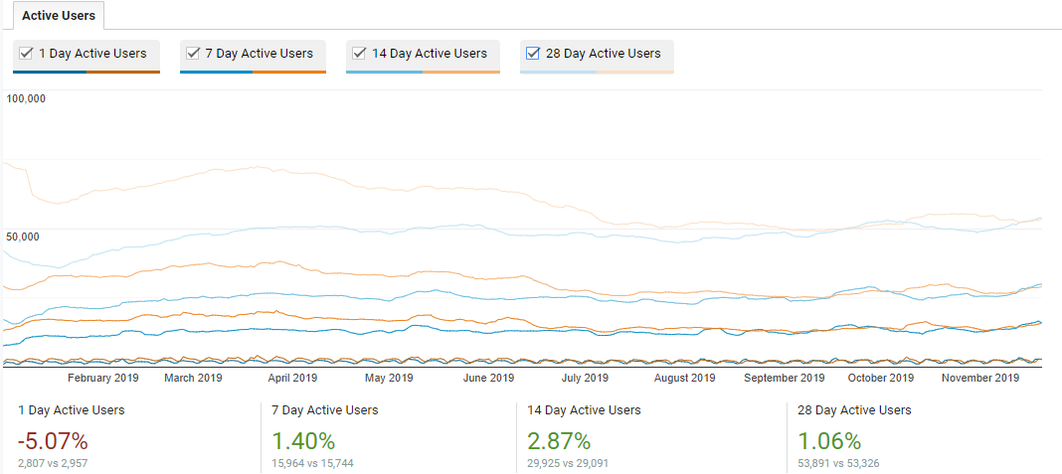
ACTIVE USER BASE: DOWN 19.14% FROM PREVIOUS YEAR
New Users is down 18.01% indicating that there is an issue with the market.
Despite steep decline of users, Avg. Pages/Session and Avg. Session Duration have slight increases. Additionally, 7, 14, and 28 day Activite User trends are showing similar patterns to previous year. The 5.07% decline in 1 Day Activity further indicates there is an issue in driving traffic to the site.
Notes:
Overall users to the site has declined 19% over the previous year, with New Users showing a decrease of 18%.
Despite this decline, we noticed that Activity trend patterns are similar to 2018 with some of the Key Success Metrics like Avg. Pages/Sessions and Avg. Session Duration even seeing slight increases. The steadiness of these metrics pared with the sharp decrease in 1 day acquisitions lead us to believe there was an issue driving new traffic to the sight. From there, we looked into campaigns from this year and last and found that 2019 had only a third the number of campaigns as 2018 which was resulting in a decrease of traffic to the site.

Slide 13
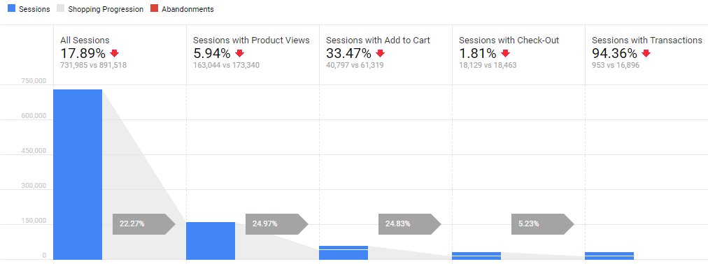
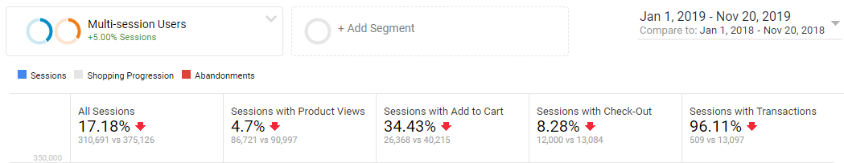
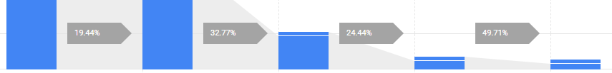
ACTIVE USER BASE: METRICS
Active User Metric Indicating Technical Issues
The decline in Active Users is resulting in fewer Sessions and having a direct and negative impact on Transactions.
This indicated an issue with Ad Campaigns but did not account for the spike in Check-Out abandonment.
The decrease in All Users and Multi-Session Users Transactions signified that there was a problem outside of normal customer behavior.
2019
2018
Notes:
The decline in Active Users is also leading to fewer overall Sessions which is having a direct and negative impact on Conversions.
However, the decrease in Active Users did not explain the high checkout abandonment rates. We found that even Multi-Session Users are abandoning transactions at an alarming rate. This alerted us to the possibility that even though our Users wanted products, they may be facing difficulties when it came to the billing & payment steps signifying that there was a problem outside of normal customer behavior. This paired with insights from our other KPIs helped us identify the loading page lag issue.

Slide 14
KPI: CHANNEL TRAFFIC
GOAL
The goal of Wish’s inbound marketing is to have most of their traffic come from organic search. High organic traffic means that people are finding the website on their own, minimizing the cost of attracting them to the site. Conversely, low organic traffic can mean that their brand recognition is low.
Because Wish is as a leader in ecommerce, they also want to see high traffic from paid sources. Knowing their Return on Advertising Spend in different areas helps them budget and plan their future marketing strategies. A drop in these areas can alert them to problems with their campaign tactics.
Goal
Conversions
ROAS
Engaged users
Entered
Check-out
Notes:
For our third KPI, we selected Ad Traffic.
Wish’s goal, like all e-commerce sites, is to have robust organic and direct channel traffic. To achieve this however, they still have to alot a large advertising budget to promote brand awareness and reminders among new and returning customers. Tracking their channel traffic, is necessary for Wish to monitor their user engagement and goal conversions, as well as being aware of their Return on Advertising Spend.

Slide 15
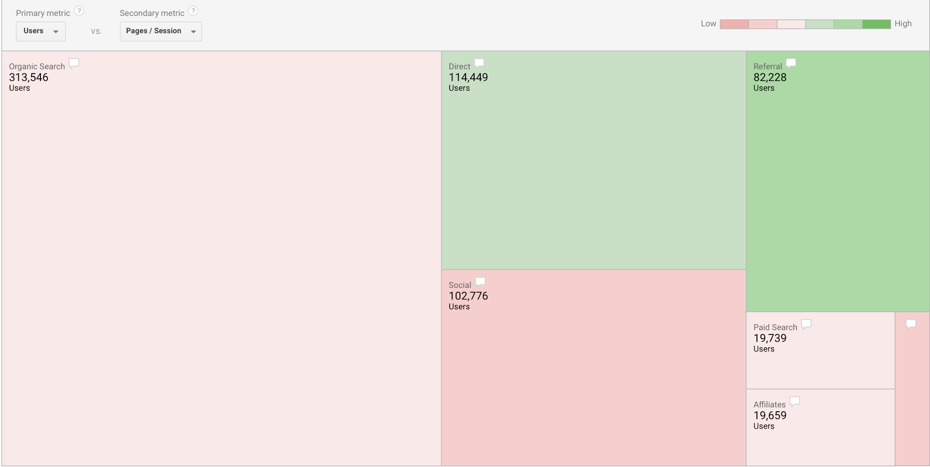
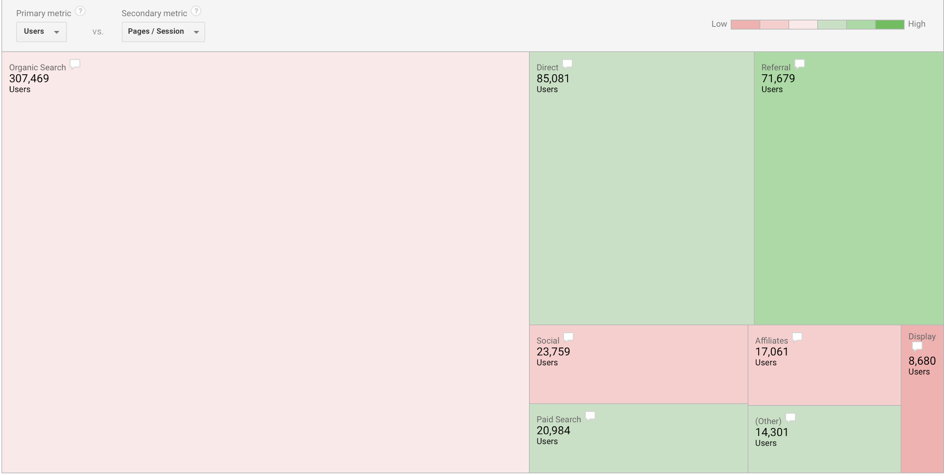
CHANNEL TRAFFIC: SOCIAL DOWN 77%
2018
2019
All channels except Paid Search are seeing a drop, but we see a drastic decline in Social Traffic (-77%) from previous year which makes it an especially concerning element to analyse. Of the Social sites, YouTube was the most significant loss with an 85% decrease in Referrals and an 81% decrease in Conversions. From this we can assume that our Youtube campaign is lacking.
Notes:
We noticed that traffic from all channels was down with the exception of Paid Search which experienced a small increase. Organic search traffic experienced only a 1.94% drop making it the least affected by the lack of campaigning which is understandable. However, Social channels experienced the highest decline at -77%. A closer look at the data revealed that of the social sites, Youtube had a significant loss of 85% indicating our campaigns there are either being shown to the incorrect market or do not have a high enough volume to draw sufficient traffic.

Slide 16
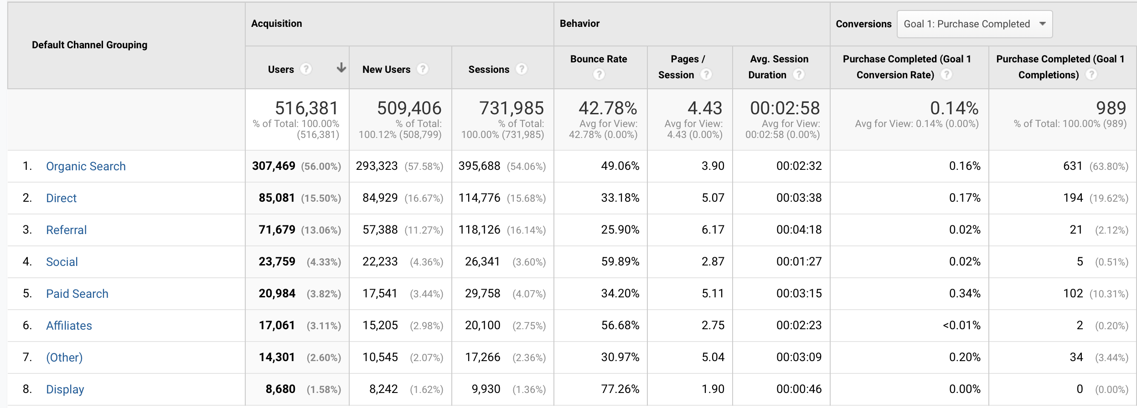
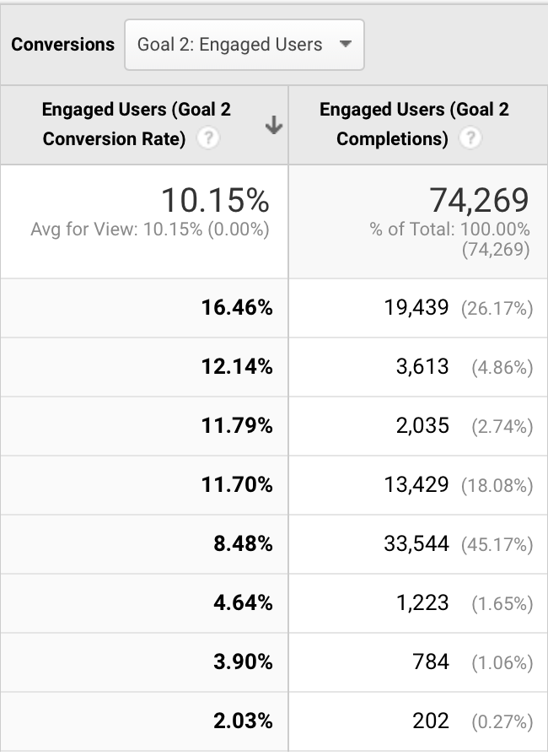
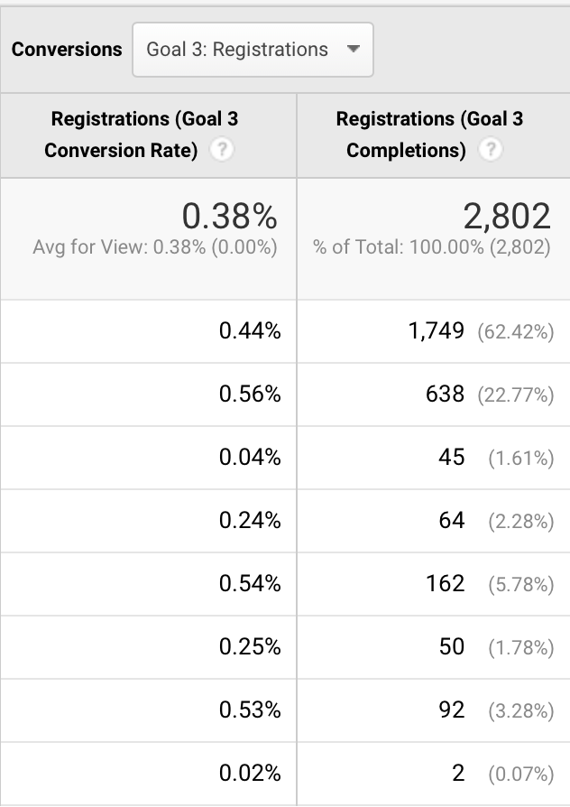
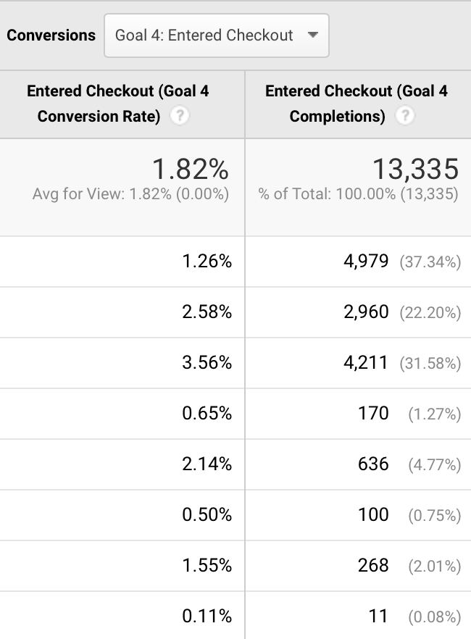
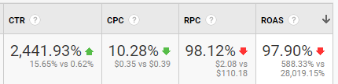
CHANNEL TRAFFIC: METRICS
Ad Traffic Metrics show E-commerce goals are being hurt by low referrals and transactions.
Conversion Rate | GOAL 1 : Purchase Completed | GOAL 2: Engaged User | GOAL 3: Registrations | GOAL 4: Entered checkout
Who stands where ? | We observe that conversion rate is highest for paid search where the goal was purchase completed. | Most of our engaged user come from organic search | Highest registrations were from direct as the traffic source. | Referrals showed the highest conversion rate to enter checkout.
Expectations/ target | The desired conversion rate for paid search has not been reached, indicating that ROAS can be improved. | Wish wants more active users as more likes, comment can lead to gains for the company. | Looking at this we surely want to improve our registrations from referral. | Referrals enter the most to checkout but as seen does not complete purchase indicating disambiguation in expectations.
CTR for 2019 is much higher than 2018, but RPC and ROAS are at dangerous lows due to User’s failure to complete transactions.
Notes:
Reviewing the Company’s Goal Conversions we found some interesting performance indicators. Even though Click Through Rate was up and Avg. customer engagement (goal 2) had increased by 3.28%, the conversions for the other goals saw severe declines from 2018’s performance.
Goal 4, “entered checkout” was down 14% which could be accounted for by the drop in overall users to the site.
However, Goal 1, “purchase complete” took a 93% hit, for this goal Paid Search saw the fewest declines making it the highest performer in that area for 2019. We can surmise that users from Paid Search traffic had the highest need and thus were willing to deal with the Payment page lags. Ultimately, the low conversion rate devastated the Return on Ad Spend meaning the advertising budget would have been almost a complete loss.

Slide 17
KPI: REPEAT CUSTOMER PURCHASE
GOAL
Shopping experience is browsing > searching, with the intent to buy. Sometimes shoppers don’t know what exactly they are looking for (brand or item). Wish.com works towards crafting a personalized experience to guide shoppers to their purchases.
In order to know whether this approach is working, looking at customer satisfaction and repeat customer purchase is essential.
The average order value of repeat customer is said to be higher than new customers (resulting in increased revenue). A business is built on customer retention rather than short sales.
Quality
Control
Customer
Satisfaction
AOV
Customer
Retention
Notes:
For our fourth kpi, we have selected rcp
Wish.com’s approach to today’s shopper who browse more than search is by crafting personalized experience. This helps wish build on customer satisfaction. In order to know whether this approach is working, looking at repeat customer purchase is essential. A business is built on customer retention rather than short sales This KPI also helps monitor quality control, customer satisfaction and AOV

Slide 18
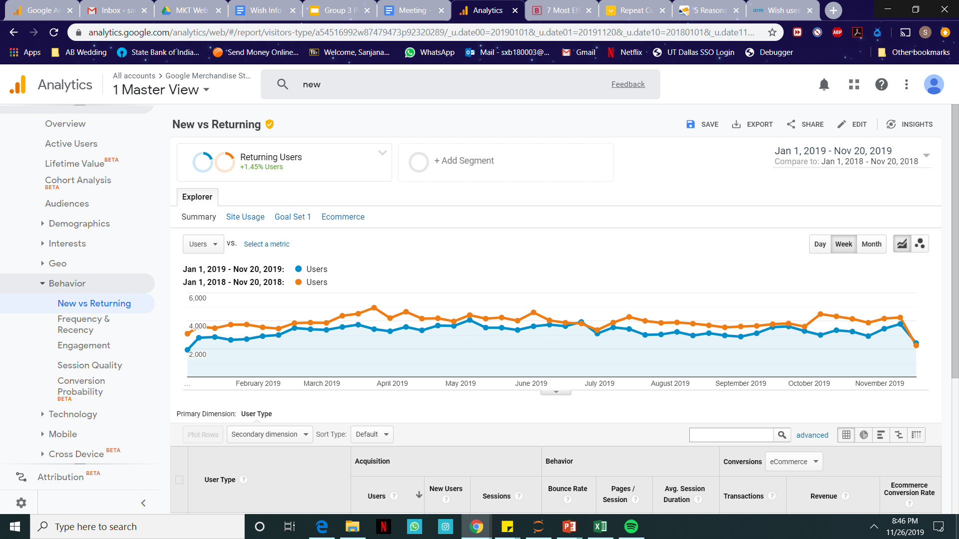
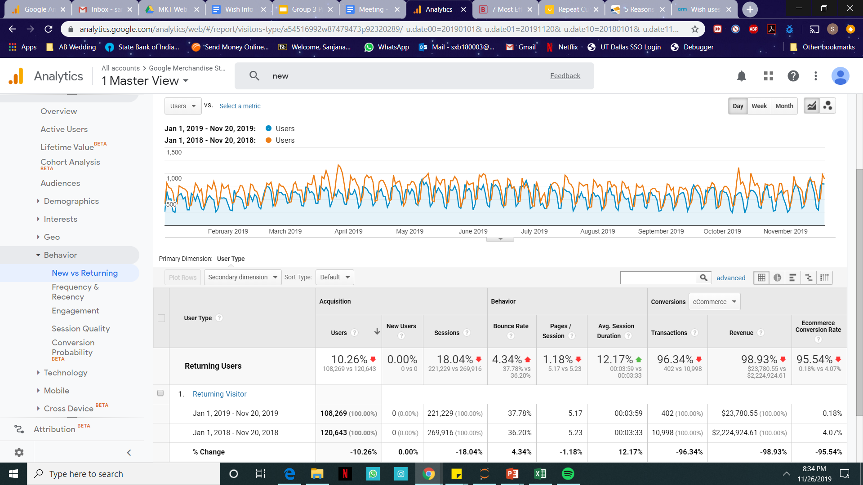
Repeat Customer
Purchase
The amount of repeat customer purchase has a 96.34% decline between 2018 to 2019
This could be due to :
Poor quality of product
Improper customer service
Lack of customer satisfaction
In May, July, October and November the number of returning visitors are almost equal for both years, possibly due to holiday season offers.
Notes:
Looking into the kpi we found that there was a 96.34% decline in returning visitor transactions

Slide 19

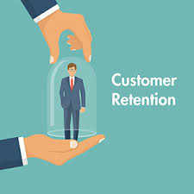


REPEAT CUSTOMER PURCHASE: METRICS
Cart Abandonment Rate: -13.55%
The Cart Abandonment rate of Returning Visitors has decreased in 2019.
However, the number of overall returning customers has decreased also.
Customer Retention: 2.2%
Customer retention for 2019 is visibly very low
Keeping Cart Abandonment Rate, Check-out Abandonment Rate, and Customer Retention as success metrics, Repeat Customer Purchase is monitored.
Checkout Abandonment Rate: -96.37%
The Checkout Abandonment Rate of Returning Visitors has increased in 2019 compared to 2018
91% of returning visitors drop off at payment
Average Order Value: -67.19%
The Average Order Value has dropped from $170 in 2018 to only $55.85 in 2019.
Total Transactions dropped by 94.47%
Notes:
Analyzing the data we found that the biggest issue we had across all KPI’s was exceedingly high Checkout Abandonment. Such a drastic decrease from the previous year lead us to review various potential causes: tracking codes not working, browser/device incompatibility, and poorly suited campaign strategies. All of those cleared, we tested our “Payment” page site speed and found it was incredibly low on desktops, as well as mobile to a smaller degree. We then analyzed device types by revenue for TY and LY, and found that desktop revenue was down $2.9M from last year so we believe that either Users are getting frustrated with the site and leaving or the payment page is not loading at all so they are unable to complete the transaction. Thanks to our review of KPI’s and Success Metrics we were able to search for and identify a critical pain-point in the data and offer a solution.

Slide 20
RECOMMENDATIONS
TECHNOLOGICAL
Fix Payment page loading issue immediately
Check that website is working properly on all device types
Ensure all tracking codes are functional
MARKETING
Increase number of Campaigns & marketing budget
Consider A/B testing for existing Campaigns
Produce high quality content (not just clickbait) to contend with competition
INCENTIVES
Improve customer loyalty program with discounts and free samples
Offer trials
30-day satisfaction guarantee
Create customer service hotline/chat, to allow customers to contact you if they are having issues on the site
PRODUCTS
Promote Nest brand products
Re-evaluate product categories and remove lines that have been unprofitable for 2+ yrs.
MARKET RESEARCH
Research emerging markets with high site usage (India & Japan)
Review Social Media presence and followers to better understand cause of declining referrals
Notes:
1 Fix Payment page loading issue immediately and run full diagnostic of the website to ensure everything is working properly.
2 Increase number of campaigns and make sure they are being targeted properly.
3 Focus on product performance and comparison: promote the product that performed well (Particularly Nest) and remove products that are not performing well this year.
4 Take action to reclaim lost customers and make it easier for them to let the company know when there is a problem with the site

